Slide 1


LC BIBFRAME Updates: Pilot
2 (and Non-Roman Scripts)
CEAL Committee on Technical Processing
March 22, 2018
Paul Frank, Library of Congress

Slide 2
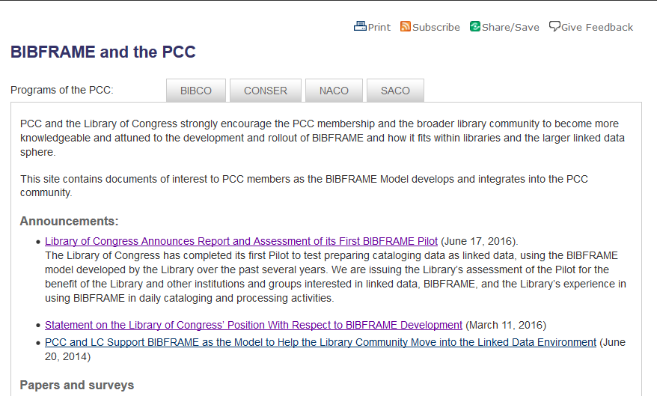
PCC
Notes:
https://www.loc.gov/aba/pcc/bibframe/bibframe-and-pcc.html

Slide 3
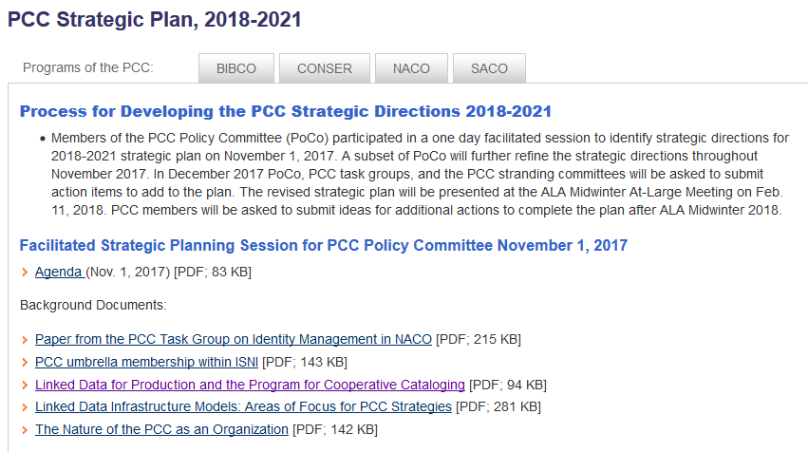
PCC Strategic Plan 2018-2021
Notes:
https://www.loc.gov/aba/pcc/about/strat-plan-2018.html

Slide 4
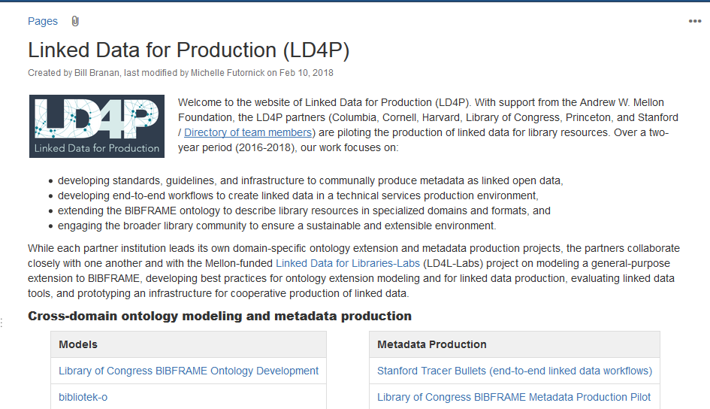
LD4P
Notes:
https://wiki.duraspace.org/pages/viewpage.action?pageId=74515029

Slide 5
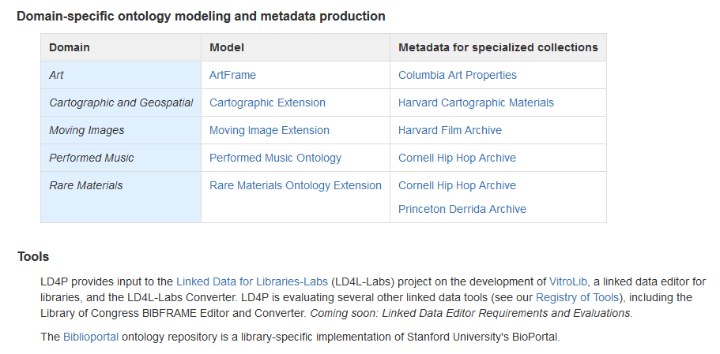
LD4P
Notes:
https://wiki.duraspace.org/pages/viewpage.action?pageId=74515029

Slide 6
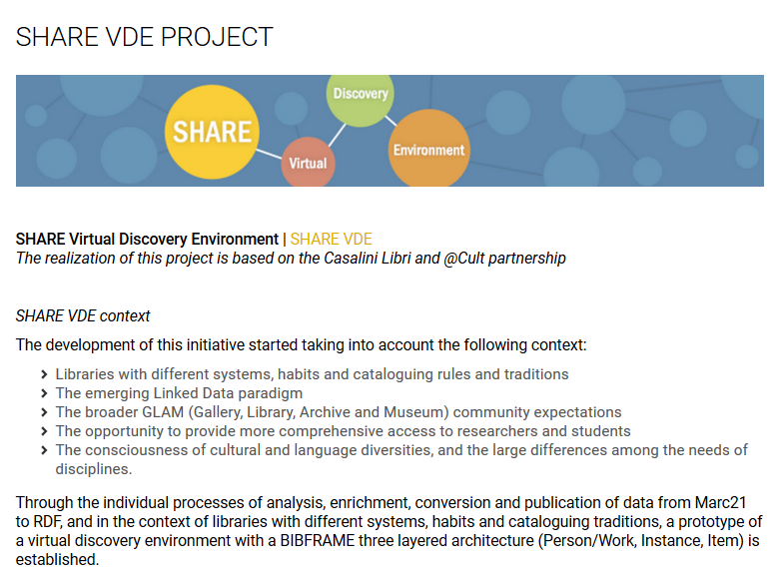
SHARE-VDE
Notes:
http://www.atcult.it/en/share-lod/share-vde/

Slide 7
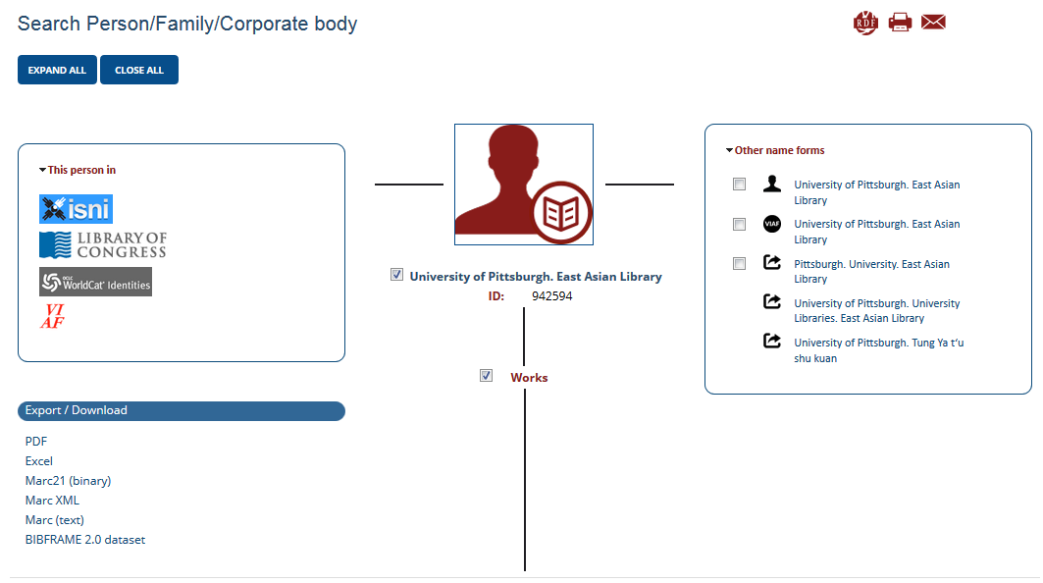
SHARE-VDE – Discovery Layer!
Notes:
http://share-vde.org/sharevde/clusters?l=en

Slide 8
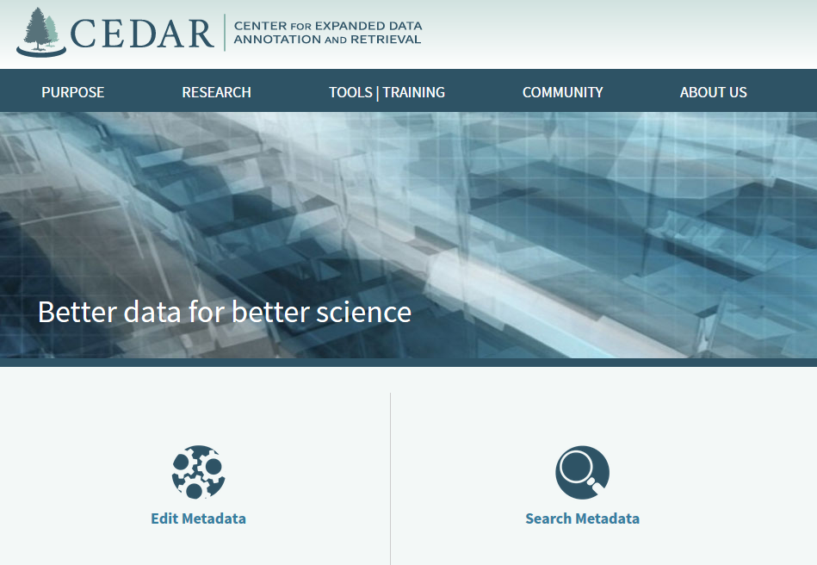
Other Projects -- CEDAR
Notes:
https://metadatacenter.org/purpose/mission

Slide 9
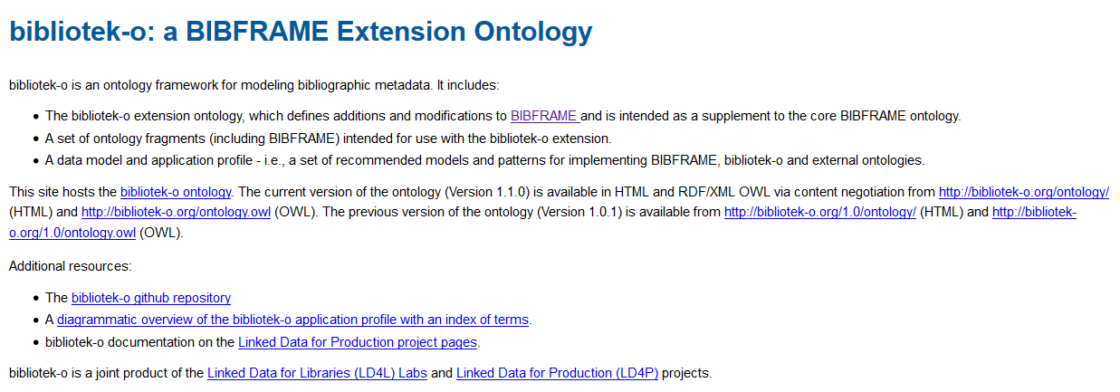
Other Projects – bibliotek-o

Slide 10
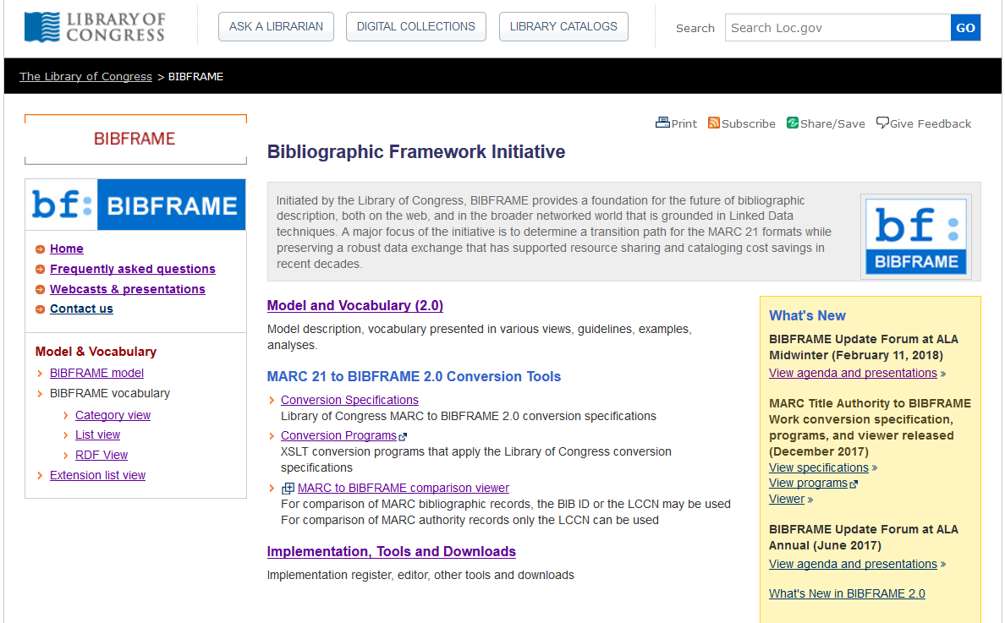
LC BIBFRAME
Notes:
http://www.loc.gov/bibframe/

Slide 11
Thank you
Paul Frank
Cooperative and Instructional Programs Division
Library of Congress
pfrank@loc.gov

